Slide 1
AVR Microcontroller and Embedded Electrovolt
Session 2

Slide 2
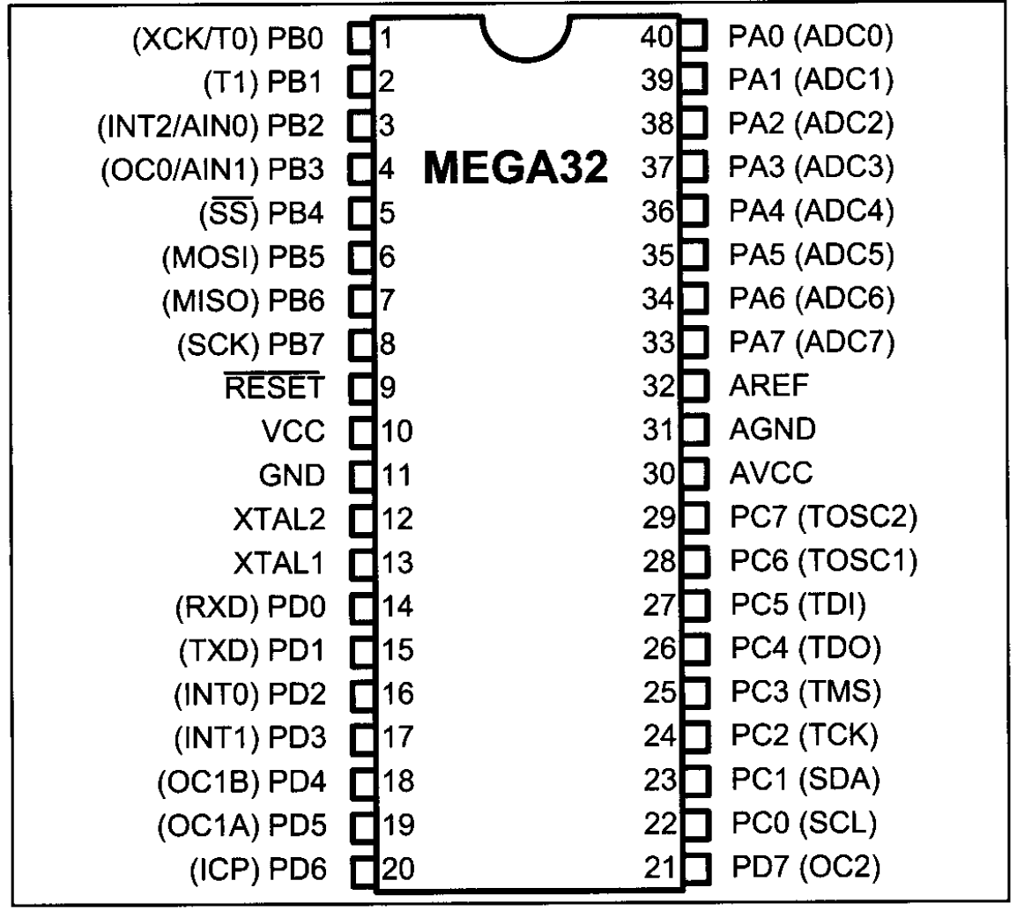
Introduction to AVR I/O interfacing

Slide 3
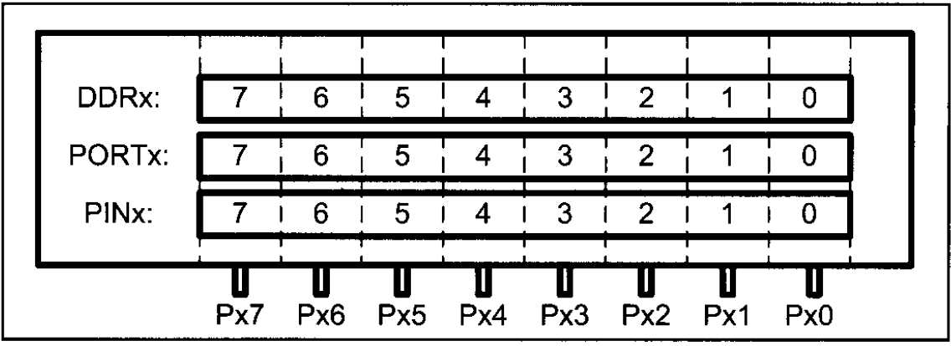
I/O port , pin and their function
direction
output
input

Slide 4
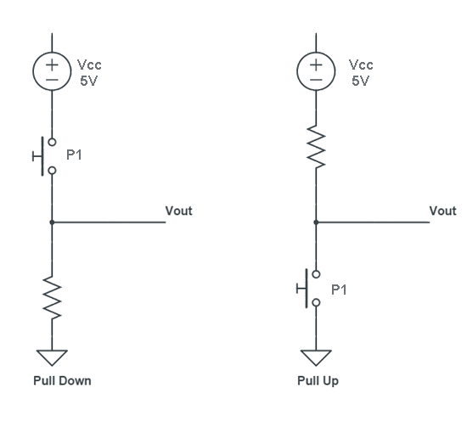
Pull-up and pull-down

Slide 5
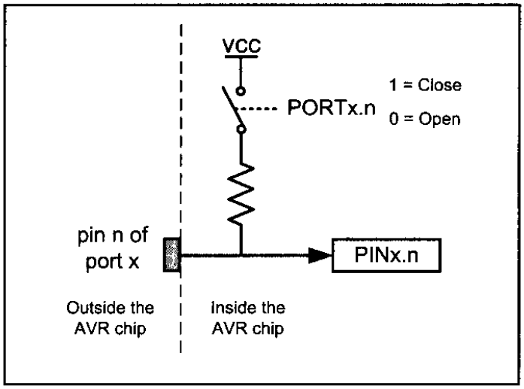
DDRx register roll
DDRx=0
output
mode
DDRx=1
DDRx=0 & PORTx=0
Tri state
Input
mode
DDRx=0 & PORTx=1
Pull-up

Slide 6
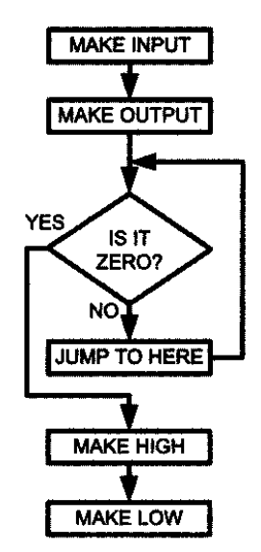
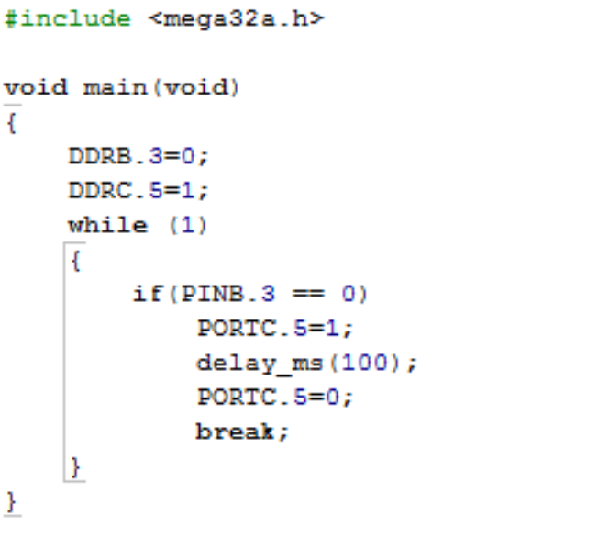
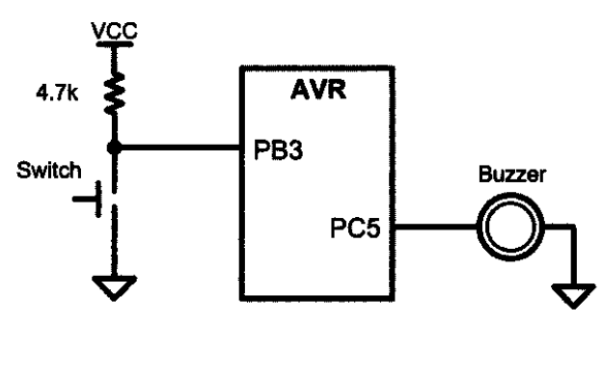
Simple program

Slide 7
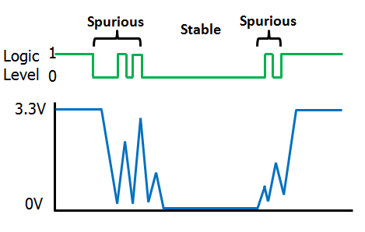
Bouncing
Ideal condition
real condition

Slide 8
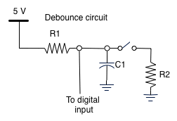
Solution ?
Hardware debouncing :
Software debouncing

Slide 9
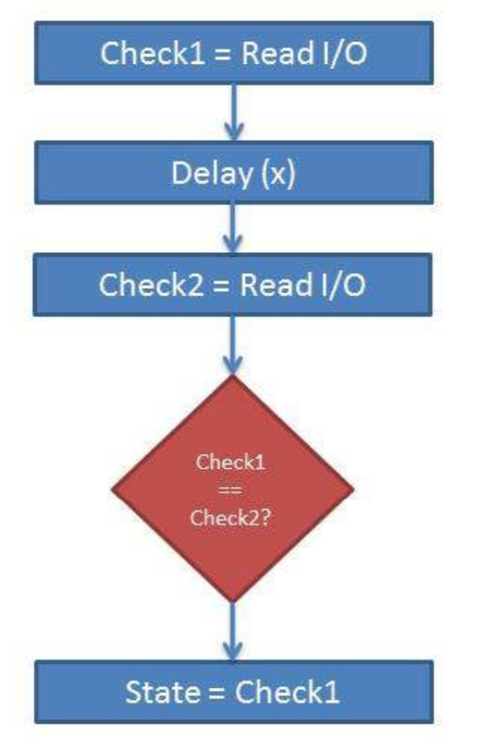
Debouncing algorithm
Read switch
If pressed
no
Not pressed
yes
delay
no
Not pressed
yes
delay
pressed

Slide 10
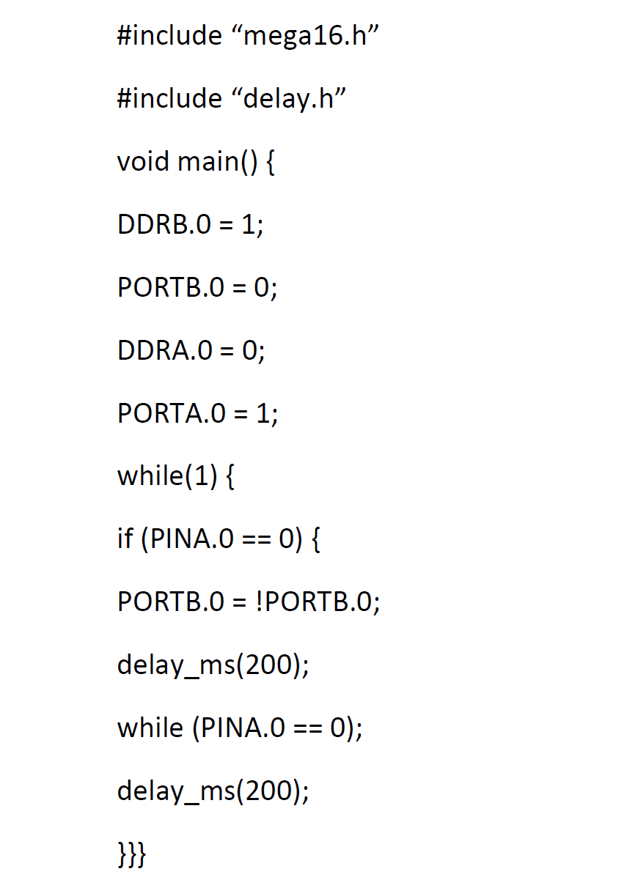
Code example
Toggle LED that connected to B0 with pull-up push-button connected to A0:
What happened
If there is no debouncing?

Slide 11
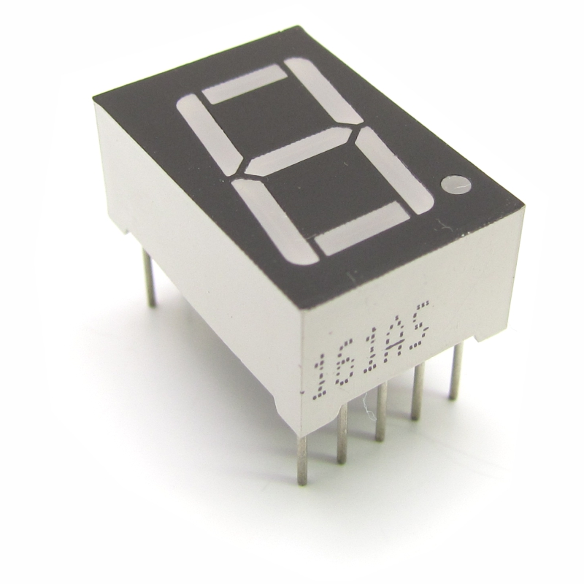
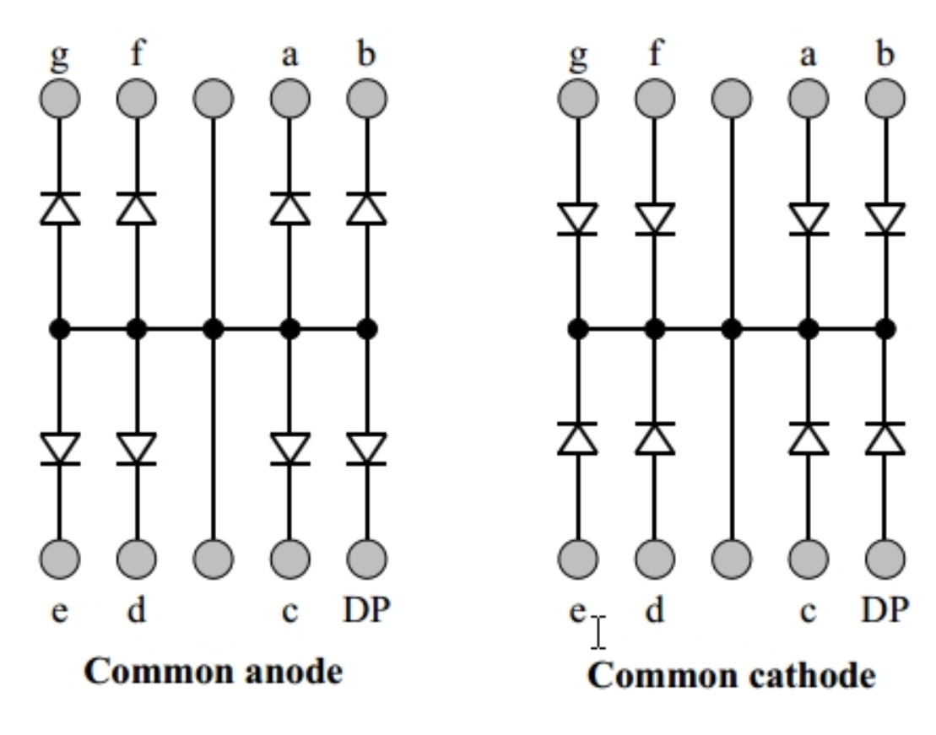
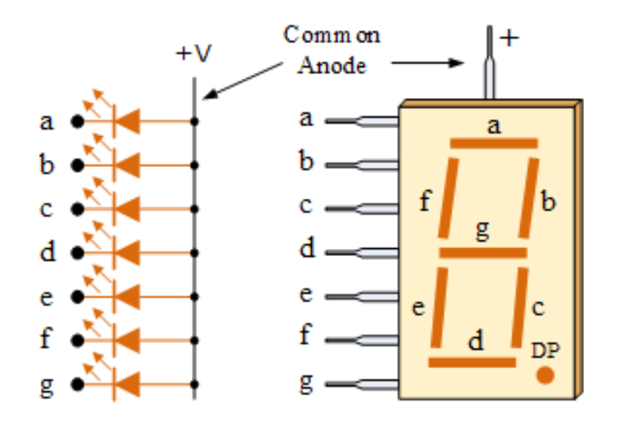
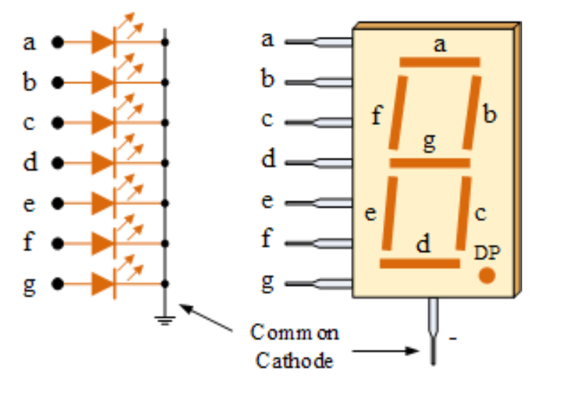
7segment

Slide 12
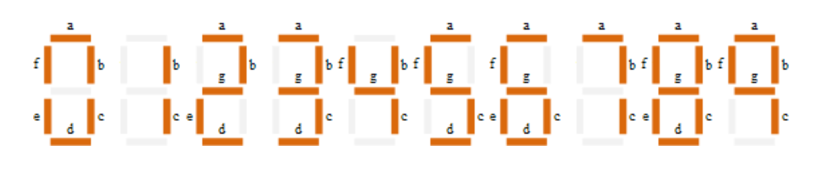
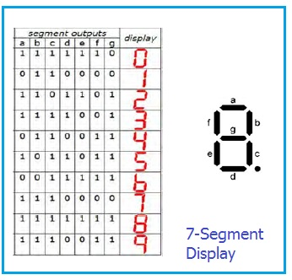
7segment

Slide 13
Alphanumeric LCD

Slide 14
Software and Driver Installation

